Slide 1

GREAT DAY!!

Slide 2
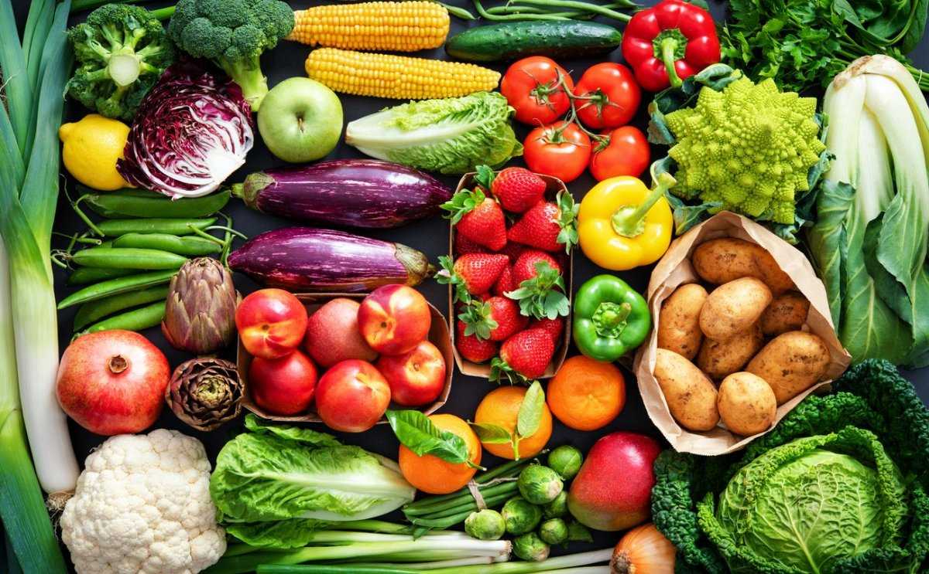


HEALTHY
FOOD

Slide 3
What is healthy food?
Notes:
Healthy food is food that gives you all the nutrients you need to stay healthy, feel well and have plenty of energy.

Slide 4
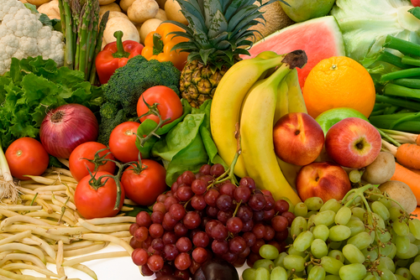
Where the essential nutriment come from?
Fruit and vegetable
50%
Notes:
Whole grains 30%
Proteins 20%

Slide 5
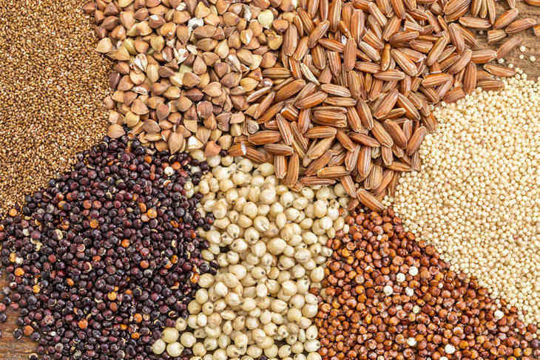
Where the essential nutriment come from?
Fruit and vegetable
50%
Whole grains
30%

Slide 6
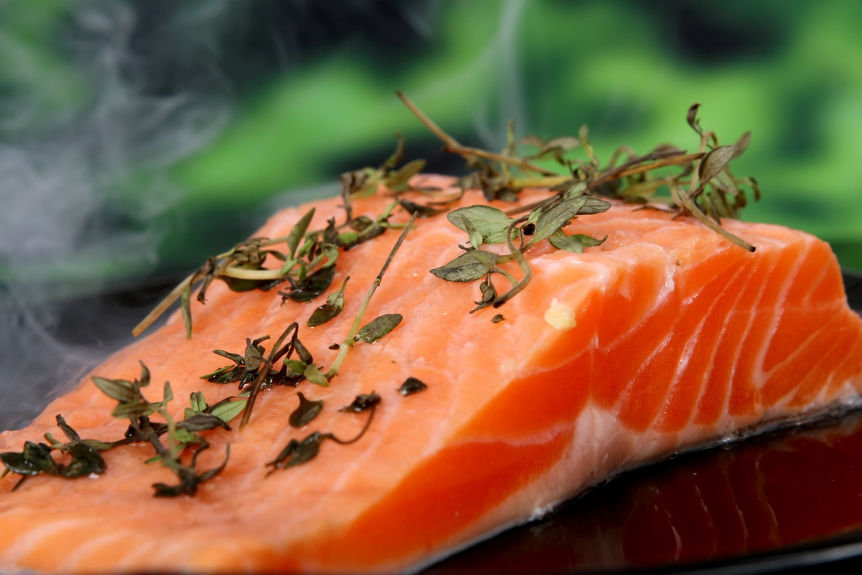
Where the essential nutriment come from?
Fruit and vegetable
50%
Whole grains
30%
Proteins
20%

Slide 7
Benefits of healthy food
Brain Health

Slide 8
Benefits of healthy food
Brain Health
Helps Lose Weight

Slide 9
Benefits of healthy food
Brain Health
Helps Lose Weight
Heart

